Slide 1
Spotify Song Characteristics
By Alec Klessig, Travis Clark, Chandler Morris, & Mychael Solis-Wheeler

Slide 2
Introducing the Dataset
Kaggle dataset of Spotify songs
Includes song characteristics (ex: tempo, duration, etc.)
Also includes values calculated by Spotify API
ex: danceability, valence, energy, etc.
Kept 7 of 17 variables
danceability, duration_ms, energy, loudness, tempo, valence, popularity

Slide 3
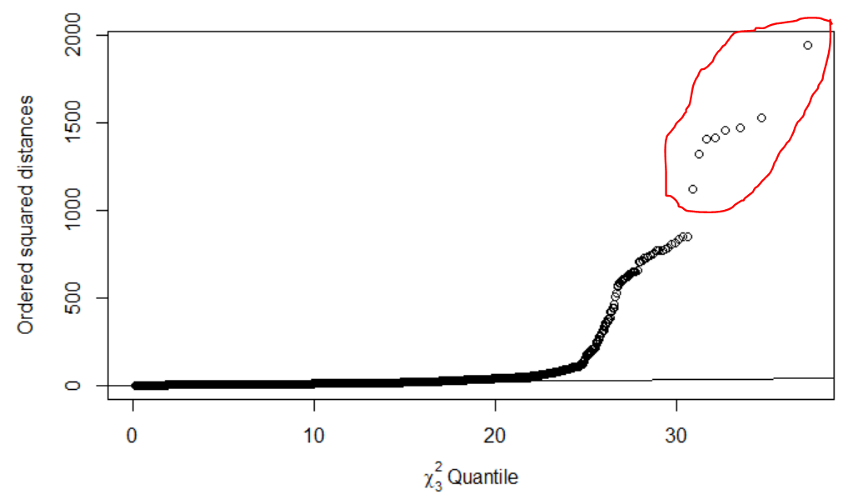
Quality of the Data
No NAs,
Generated by API
Not MV normal

Slide 4
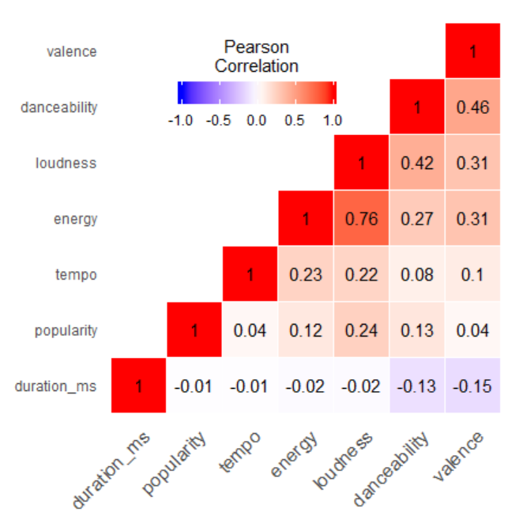
Visualizing the Data
Low correlation
Poor PCA, EFA
Exceptions:
energy and loudness = 0.76
danceability and
valence = 0.46
loudness = 0.42

Slide 5
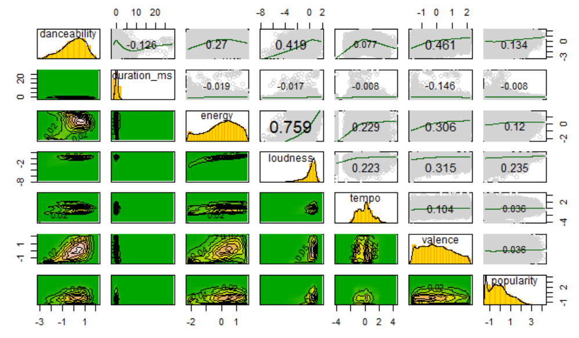

Slide 6
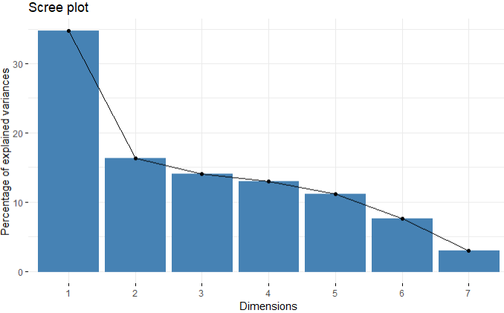
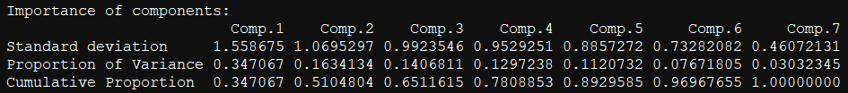
Dimension Reduction - PCA
The first 2 principal components add up to 51.04% of the data
1st component is 34.70%
2nd component is 16.34%

Slide 7
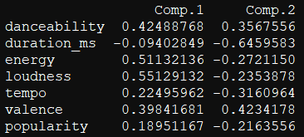
PCA - Continued
Comp 1
Contrast between pos. Energy, Loudness, and Danceability.
Comp 2
Contrast between pos Valence and neg. Duration_ms
Notes:
Unsure about this slide. May be just better to replace this with component interpretations.

Slide 8
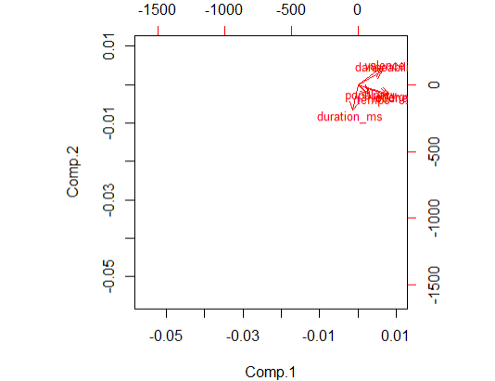
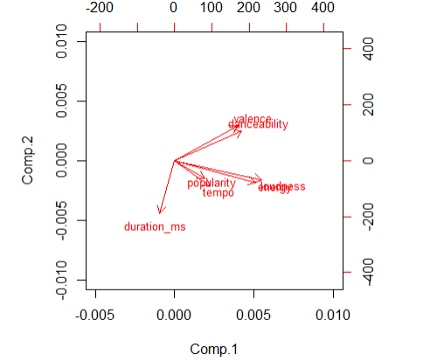
PCA - Continued
Highest to lowest correlation
energy and loudness, danceability and valence, popularity and tempo.

Slide 9
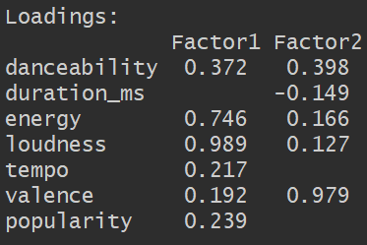
Exploratory Factor Analysis
First need suggested factors for CFA since not starting with a preset theory
Begin EFA with sliced Spotify dataset, factors = 1
RMSE = 0.076 > 0.05, not ideal
Set factors = 2, try again
RMSE = 0.028 < 0.05, so 2 factors for EFA
Use results from EFA for next step
Notes:
Not sure picture is necessary here.
May want to add something about interpreting the factors here. Otherwise, theory we try to confirm in CFA won’t make much sense.

Slide 10
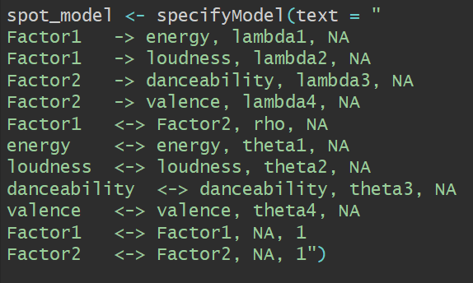
Confirmatory Factor Analysis
First CFA run using this model
Cut out variables with loading less than 0.4
GFI = 0.986
AGFI = 0.858
SRMR = 0.029

Slide 11
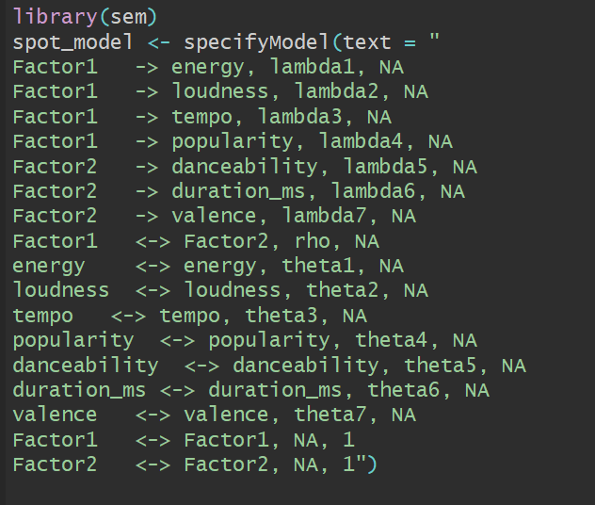
Confirmatory Factor Analysis
Second CFA run using this model, all variables
GFI = 0.982
AGFI = 0.961
SRMR = 0.032
P-value = 0 (very large # of observations)

Slide 12
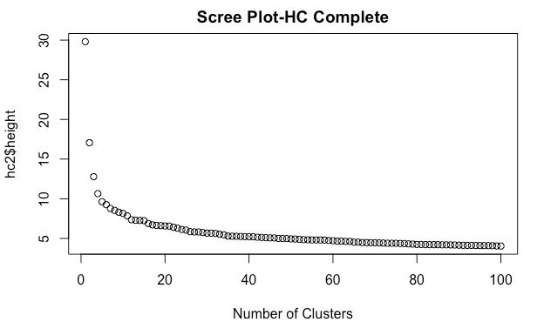
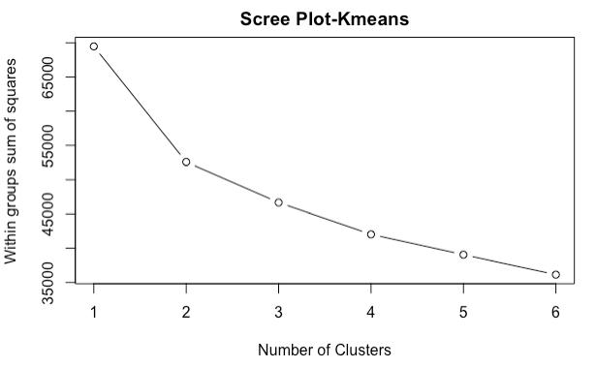
Cluster Analysis: Pre-clustering
First, got random sample of n = 10,000 out of this big (>n = 100,000) dataset.
Then conducted Scree plots for both HC & K-means clustering:
Notes:
Optimal clustering was 2 for both HC & K-means clustering (k = 2)

Slide 13
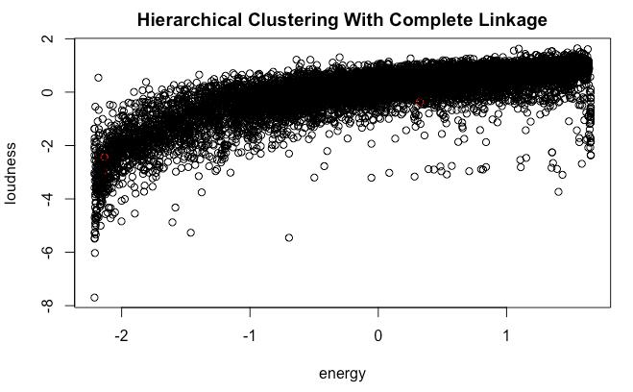
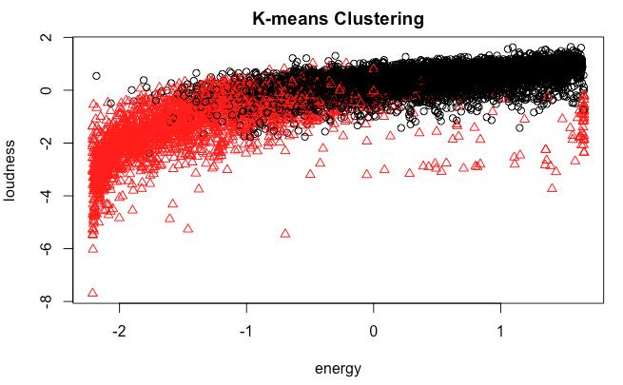
Cluster Analysis: HC vs K-means Clustering
Notes:
HC Clustering Complete: Cluster 1 (9997) vs Cluster 2 (3) NOTE: All HC types were this way
vs
K-means Clustering Centers: Cluster 1 (7770) vs Cluster 2 (2230) NOTE: Better clustering here

Slide 14
Cluster Analysis: K-means Clustering
Notes:
K-means Clustering Centroids of energy to loudness:
Cluster 1 (7770): energy (0.38) & loudness (0.40) = high energy/loudness
Cluster 2 (2230): energy (-1.28) & loudness (-1.34) = low energy/loudness
K-means cluster centroids of ALL variables:
danceability duration_ms energy loudness tempo valence popularity
Cluster 1 (7770): 0.286 -0.045 0.383 0.402 0.141 0.243 0.115
Cluster 2 (2230): -1.039 0.111 -1.279 -1.342 -0.479 -0.782 -0.350

Slide 15
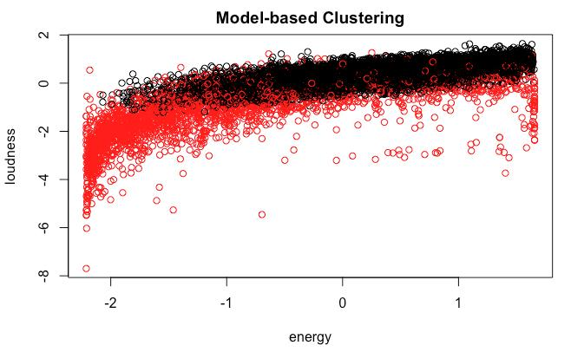
Cluster Analysis: Model-based Clustering
Notes:
Model-based Clustering Centroids of energy to loudness:
Cluster 1 (7652): energy (0.28) & loudness (0.39) = high energy/loudness
Cluster 2 (2169): energy (-1.05) & loudness (-1.39) = low energy/loudness
Model-based cluster centroids of ALL variables:
danceability duration_ms energy loudness tempo valence popularity
Cluster 1 (7652): 0.270 -0.081 0.293 0.403 0.093 0.166 0.149
Cluster 2 (2348): -0.921 0.223 -0.900 -1.257 -0.292 -0.48 -0.435

Slide 16
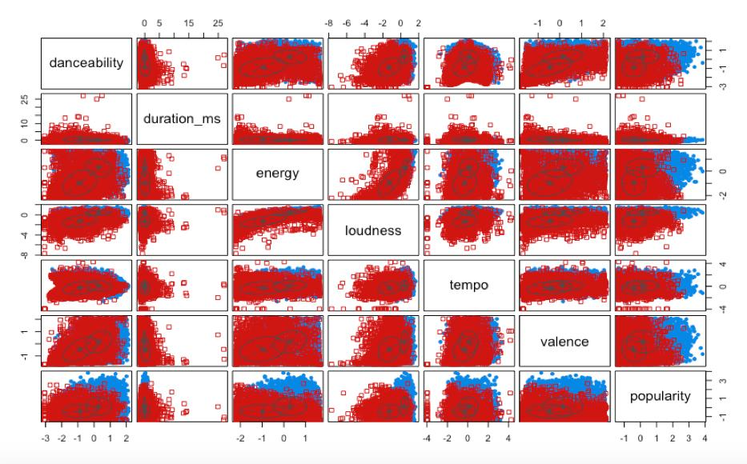
Notes:
-Good clustering means groups are even but they are NOT!
-The Mclust R command relies on the data being MV normal.
-None of the variables had a normal distribution for clustering.

Slide 17
Conclusion: Applications of Results
Songs that tend to be loud are also considered high-energy songs
Songs that are danceable make you feel good
Songs do not need all 7 variables to be described
Just need 2 factors: Power & Vibe
Notes:
-Songs that tend to be loud also tend to be high-energy songs
-Songs that are danceable make you feel good
-Songs do not need all 7 variables to be described. They just need 2 factors: Power & Vibe

Slide 18
Conclusion: Lessons Learned
Real world data can be messy
i.e. not MV normally distributed, low correlation, etc.
Balance between cleaning and completeness of data
Hard to interpret and visualize messy data
Additional reduction techniques can be used
Notes:
-Real world data can be messy, which may not give clean results you want from techniques (not MV normally distributed, low correlation, etc.)
-Balance between cleaning and completeness of data
-Sometimes judgement calls are made for interpreting/visualizing data, which is a lot more subjective than desired for messy data.
-Additional reduction techniques can be used to make data objective. Consider resorting, ranking (top 100, top 1000), or random sampling from big data.

Slide 19
Questions?

